Slide 1
Ohio Gross Domestic Product (GDP)

Slide 2
Ohio’s economy ranks 7th largest among states
2021 Gross Domestic Product (GDP) by State
State | Total Amount ($ billions) | Rank | Per-Capita Amount | Rank
U.S. | $22,996.1 | -- | $69,287 | --
Ohio | $736.4 | 7 | $62,517 | 26
Neighboring States
Pennsylvania | $839.4 | 6 | $64,751 | 23
Michigan | $568.4 | 14 | $56,554 | 35
Indiana | $420.3 | 17 | $61,760 | 30
Kentucky | $234.5 | 28 | $52,002 | 43
West Virginia | $87.4 | 41 | $49,017 | 48
Top Ranked State | $3,356.6 | California | $93,463 | New York
Ohio’s GDP, the broadest measure of economic production, increased 8.7% in 2021 from 2020.
Of Ohio’s neighbors, only Pennsylvania ranked higher for total GDP or on a per-capita basis in 2021.
In nominal terms (i.e., not adjusted for inflation), Ohio’s economy grew mostly at a slower rate (3.4%) than the U.S. as a whole (4.0%) during the ten-year period ending in 2021.
Over the last decade, average annual nominal economic growth was faster in Indiana (3.8%) and Michigan (3.5%) than in Ohio; and West Virginia had the slowest economic growth of the region (2.5%).
Source: U.S. Bureau of Economic Analysis

Slide 3
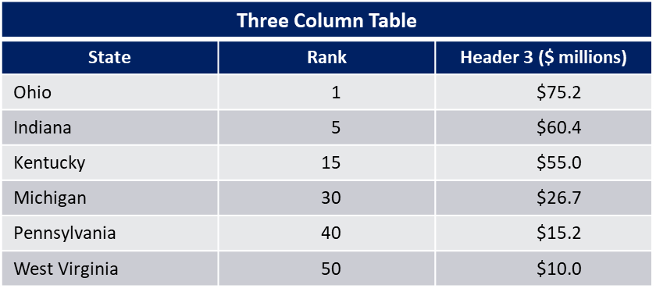
Ohio GDP growth has lagged that of the U.S.
Source: U.S. Bureau of Economic Analysis
Ohio’s annual nominal GDP growth has exceeded U.S. annual GDP growth four times between 1998 and 2021.
During that period, Ohio’s average annual GDP growth was 3.3%, less than the U.S. average of 4.2%, and exceeding only that of Michigan (2.8%), Connecticut (3.2%), and New Mexico (3.2%).
Between 1998 and 2021, North Dakota experienced the highest average annual GDP growth (6.1%).
Average Annual Nominal GDP Growth Rates (1998-2021)
State | Percent | Rank
Ohio | 3.3% | 47
Indiana | 3.8% | 31
Kentucky | 3.4% | 43
Michigan | 2.8% | 50
Pennsylvania | 3.7% | 35
West Virginia | 3.4% | 42

Slide 4
Manufacturing’s share of the economy in Ohio exceeds that in the U.S. as a whole
Output of factories accounted for 16% of Ohio’s GDP and 11% of the nation’s GDP in 2021.
With a value of factory output of $117.9 billion in 2021, Ohio was the 4th leading state for that measure, trailing only output in California, Texas, and Illinois.
Production of goods were 22% of Ohio’s GDP and 18% of U.S. GDP.
Private services were 68% of the value of economic activity in Ohio and 70% of that of the nation.
Government services accounted for about 11% of Ohio’s GDP, less than the U.S. figure of 12%.
Source: U.S. Bureau of Economic Analysis

Slide 5
Manufacturing has the largest variance in industry shares between Ohio and the U.S.
As a share of GDP, Ohio’s factory output was 16.0%, higher than manufacturing factory output for the U.S. of 11.1%, yielding a positive variance of 4.9%.
The finance and insurance and health care/social assistance sectors had the next largest industry share positive variances, 2.4% and 1.2%.
The sectors with the largest negative variances were information; professional, scientific, and technical services; and real estate/leasing, -3.2%, ‐2.6%, and -1.9%, respectively.
In total, private goods-producing industries were 21.5% of Ohio’s GDP compared to 17.6% for the nation’s GDP.
Source: U.S. Bureau of Economic Analysis

Slide 6
Ohio ranks 9th nationally in the value of exports
Top States in Exports in 2021
Rank | State | 2020 (in billions) | 2021 (in billions) | % Change 2020-2021
1 | Texas | $279.3 | $375.3 | 34.4%
2 | California | $156.1 | $175.1 | 12.2%
3 | New York | $61.9 | $84.9 | 37.1%
4 | Louisiana | $59.6 | $76.8 | 28.8%
5 | Illinois | $53.5 | $65.9 | 23.2%
6 | Michigan | $44.0 | $55.5 | 26.2%
7 | Florida | $45.8 | $55.5 | 21.1%
8 | Washington | $41.3 | $53.6 | 29.9%
9 | Ohio | $45.0 | $50.4 | 12.0%
In 2021, the value of Ohio’s exports to foreign countries was the 9th highest among states, accounting for 2.9% of total U.S. exports.
Ohio’s export value was 6.8% of the state’s GDP, lower than the U.S. average of 7.6%.
On a per-capita basis, Ohio’s exports value of $4,280 ranked 22nd and was lower than the U.S. average per-capita value of $5,287.
Canada’s purchases were $18.38 billion (36.4%) of Ohio’s exports, followed by Mexico, $6.29 billion (12.5%), and China, $3.75 billion (7.4%).
High growth rates in 2021 were related to decreased exports in 2020 due to constraints the COVID-19 pandemic placed on trade.
Sources: U.S. Census; U.S. Bureau of Economic Analysis

Slide 7
Industrial machinery and vehicle sectors lead Ohio exports in 2021
Value of Exports by Sector ($ billions)
Sector | 2021 value | % of all exports
Industrial Machinery | $8.3 | 16.5%
Vehicles and Parts | $7.8 | 15.5%
Aircraft/Spacecraft and Parts | $4.1 | 8.2%
Plastics | $3.3 | 6.5%
Electric Machinery | $3.0 | 6.0%
Oil Seed/Grain | $2.2 | 4.4%
The top six production sectors above accounted for $28.5 billion (57.1%) of the total value of Ohio exports.
The next six production sectors, exceeding $1 billion each, accounted for $7.8 billion (15.4%) of exports –optical/medical instruments ($1.7 billion), iron/steel ($1.5 billion), perfumery and cosmetics ($1.2 billion), and miscellaneous chemicals, soap/waxes/lubricants, and iron/steel products ($1.1 billion each).
Source: U.S. Census Bureau

