Slide 1
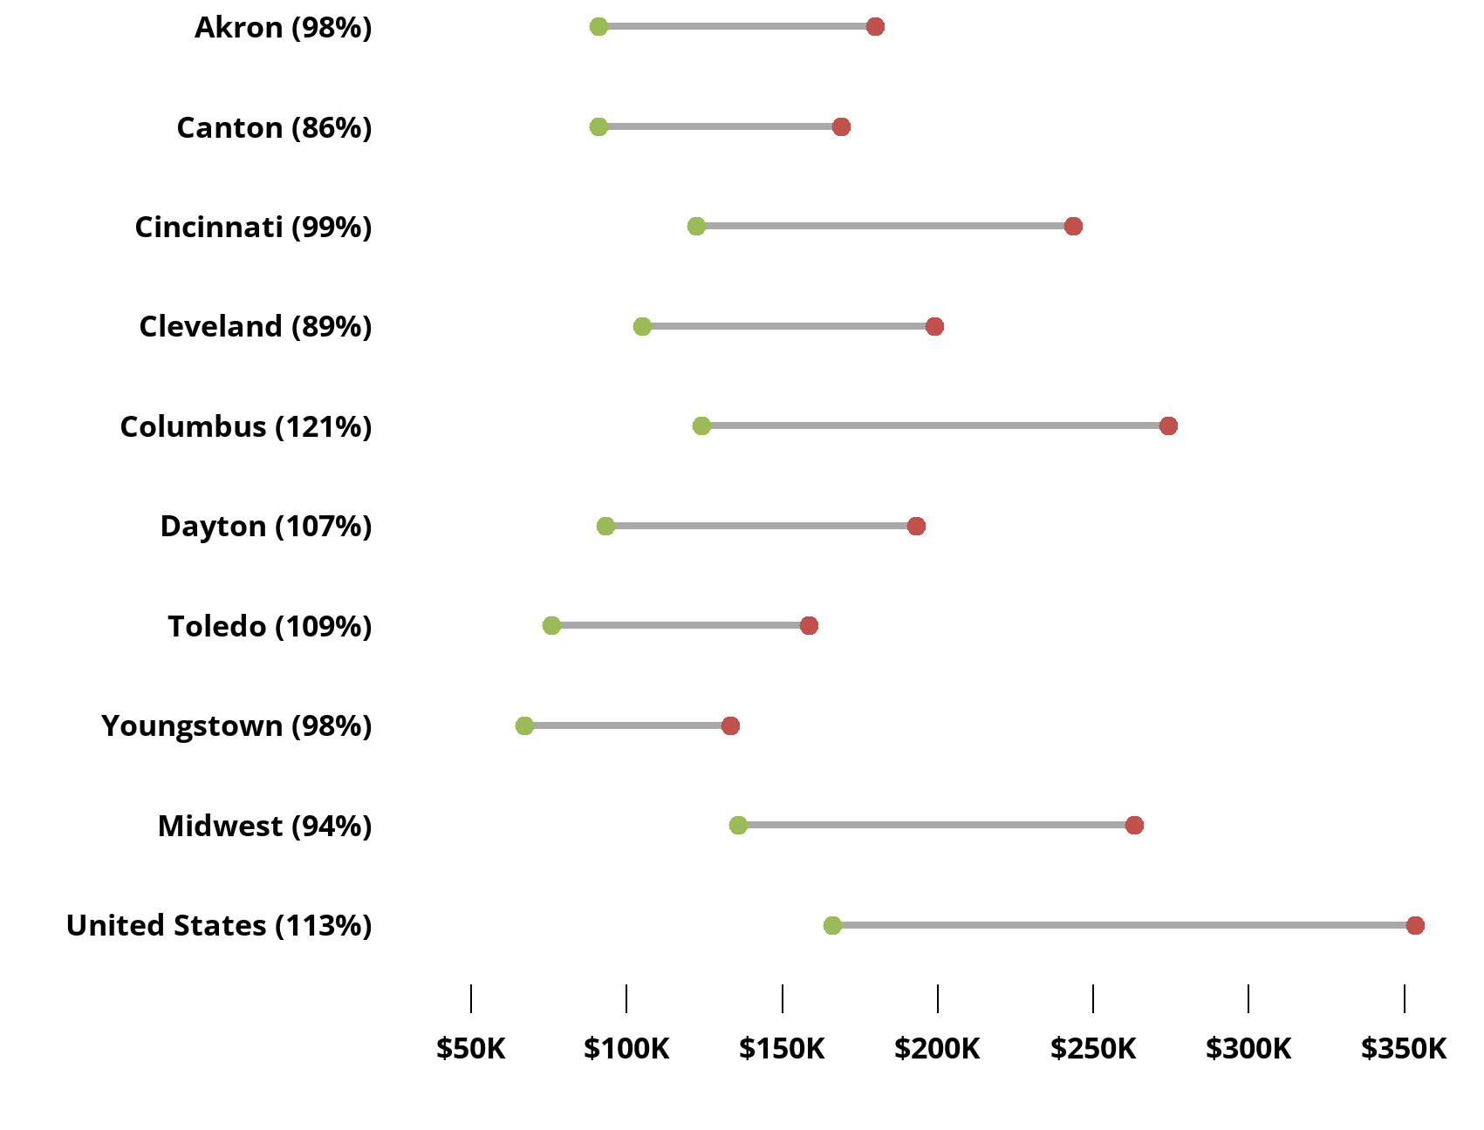
Median home prices in Ohio are growing, but at rates that are mostly lower than the U.S. overall
Median Home Sales Price 2011-2021
From 2011-2021, median home prices in Ohio’s eight major metropolitan statistical areas (MSAs) climbed between 86% in Canton and 121% in Columbus.
Median home prices in six of Ohio’s MSAs gained at a higher rate than the Midwest median.
The Columbus area was the sole major market in Ohio where growth in median home prices surpassed that of the U.S. overall.
Source: National Association of Realtors

