Slide 1
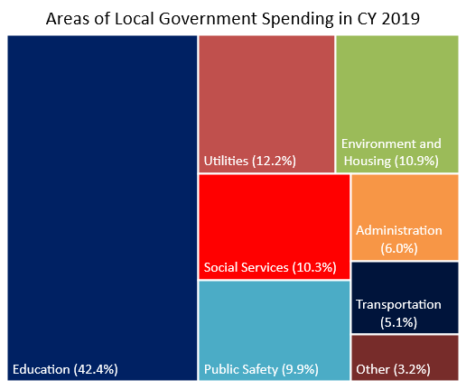
Ohio’s local government expenditures reached nearly $64.9 billion in CY 2019
Local government spending totaled almost $64.9 billion in CY 2019.
  Education was by far the largest spending area ($27.5 billion, 42.4%), followed by Utilities ($7.9 billion, 12.2%), Environment and Housing ($7.1 billion, 10.9%), Social Services ($6.7 billion, 10.3%), Public Safety ($6.4 billion, 9.9%), Administration ($3.9 billion, 6.0%), Transportation ($3.3 billion, 5.1%), and Other ($2.1 billion, 3.2%).
  Of total spending, $57.5 billion (88.6%) was for services and government operations. The remaining $7.4 billion (11.4%) went for capital outlays.
  Local government payroll expenditures amounted to nearly $24.8 billion (38.3%).
Local governments collected just over $61.6 billion in CY 2019.
  Local governments generated $38.9 billion (63.1%) from their own sources. This included $25.7 billion (66.1%) from property, income, sales, and other taxes, and $13.2 billion (33.9%) from service charges and miscellaneous revenues.
  The remaining $19.5 billion (31.7%) came from governmental transfers, mainly from the state. Local government utilities generated $3.2 billion (5.2%) in revenue.
Source: U.S. Census Bureau

