Slide 1
School District Taxable Property Values

Slide 2
Residential and agricultural property comprise the bulk of state total taxable value
Class I real property value: $220.32 billion (71.8%)
Residential value: $204.02 billion (66.5%)
Agricultural value: $16.30 billion (5.3%)
Class II real property value: $59.89 billion (19.5%)
Commercial value: $46.84 billion (15.3%)
Industrial value: $11.46 billion (3.7%)
Mineral and railroad value: $1.59 billion (0.5%)
Public utility tangible personal property (PUTPP) value: $26.66 billion (8.7%)
Includes property used for production, transmission, and distribution
Taxable property value composition varies by school district
Taxable Property Value Composition by District Type, 2020
Type | % Res. | % Agr. | % Class II | % PUTPP
Rural | 47.5% | 20.3% | 9.5% | 22.7%
Small Town | 64.6% | 8.2% | 16.7% | 10.5%
Suburban | 76.1% | 1.0% | 18.9% | 4.0%
Urban | 61.7% | 0.2% | 31.8% | 6.3%
Source: Ohio Department of Taxation

Slide 3
Suburban and urban district real property values have grown the fastest since 2017
All school district types have gained real property value since 2017. Statewide, real property value increased 13.3%.
Values increased the fastest in suburban and urban districts, at 15.9% and 14.3%, respectively.
Small town and rural district real property values grew more slowly, at 11.1% and 6.8%, respectively, due to decreases in agricultural real property value.
Statewide change in Class I property values by property type, 2017-2020:
16.2% Residential
-10.4% Agricultural
County auditors reappraise real property values every six years and update values in the third year following each reappraisal.
Source: Ohio Department of Taxation

Slide 4
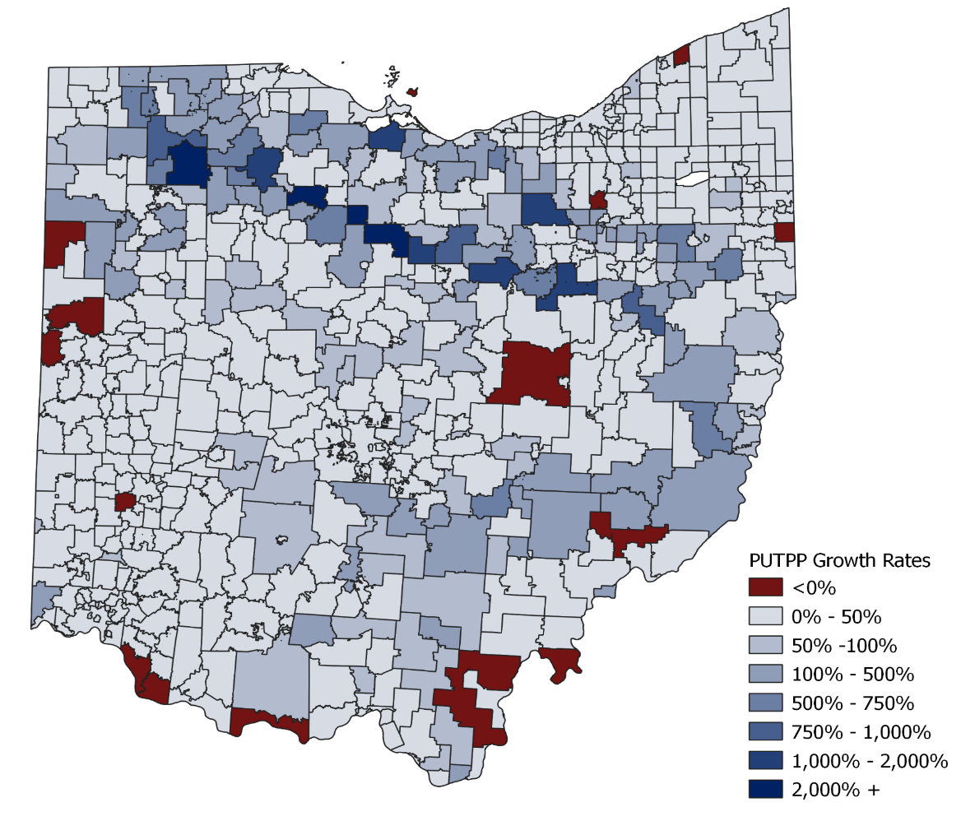
Public utility tangible personal property values have grown rapidly in northern and southeastern regions
Public Utility Tangible Personal Property Value Growth by School District, TY 2017-TY 2020
Public utility tangible personal property (PUTPP) values grew rapidly from 2017 to 2020, increasing 62.3% statewide.
This value grew fastest in various school districts in northern and southeastern Ohio led by the completion of the Rover Pipeline, which carries natural gas from shale production areas to markets in the U.S. and Canada.
Districts with the largest growth (shaded in darker blues in the adjacent map) are generally located along the pipeline’s path.
Growth in these districts ranges from Buckeye Central Local in Crawford County, at about 40 times 2017 values (a growth rate of nearly 3,900%) to Crestview Local in Richland County, at about nine times (765%).
Fifteen districts lost PUTPP value since 2017 (shaded in red).
Many have coal-fired or nuclear power plants in their territory.
Examples: Manchester Local in Adams County (-72.9%), Perry Local in Lake County (-26.7%), New Richmond Exempted Village in Clermont County (-17.9%), and River View Local in Coshocton County (-15.1%).
Unlike existing real property, PUTPP value is not affected by tax reduction factors; taxes on this property grow at the same rate as property values grow.
Source: Ohio Department of Taxation

