Slide 1
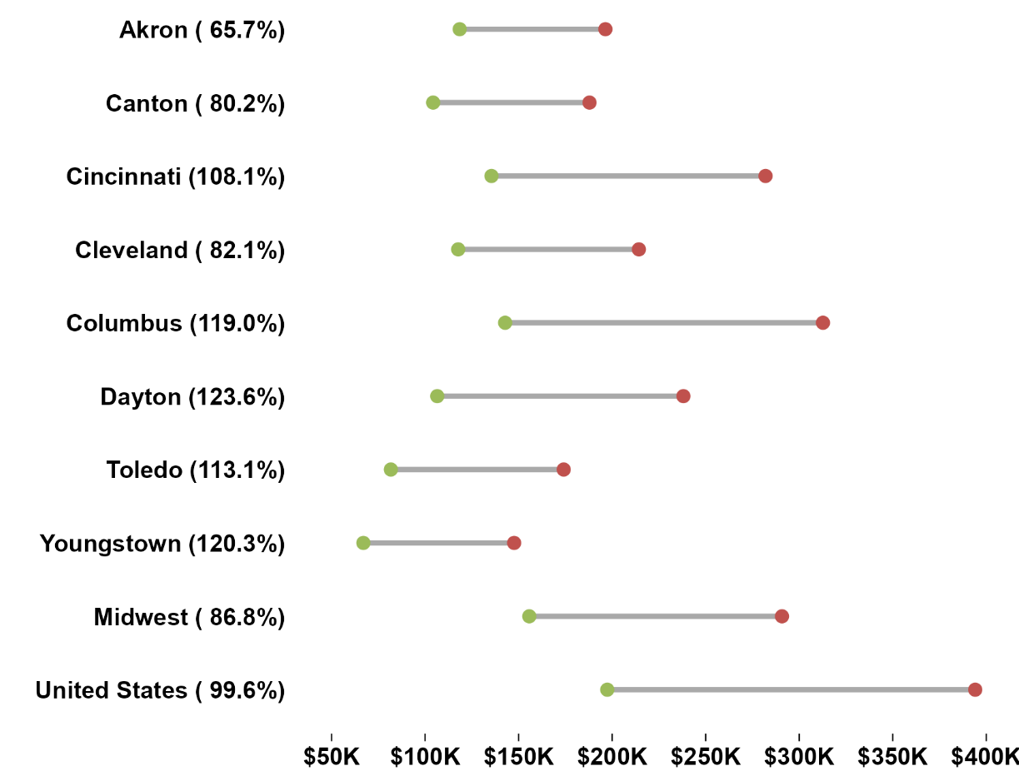
Median home prices in Ohio are growing, more than doubling in five of the eight MSAs
Median Home Sales Price 2013-2023
From 2013-2023, median home prices in Ohio’s eight major metropolitan statistical areas (MSAs) climbed between 65.7% in Akron and 123.6% in Dayton.
Median home prices in five of Ohio’s MSAs gained at a higher rate than both the Midwest and U.S. medians.
Over the last decade, the median housing price for five of Ohio’s eight MSAs more than doubled.
Source: National Association of Realtors

