Slide 1
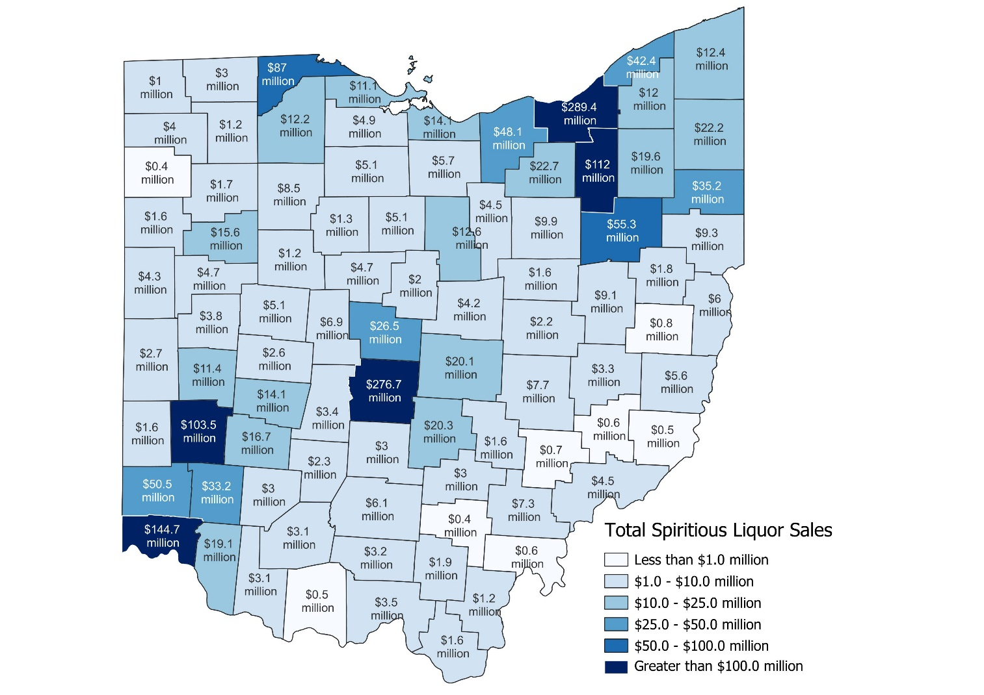
Spirituous liquor sales exceeded $100.0 million in five counties in FY 2024
Statewide spirituous liquor sales topped $1.76 billion in FY 2024.
  Retail sales accounted for nearly $1.35 billion (76.2%) of the statewide total.
  Wholesale sales accounted for the remaining $419.3 million (23.8%).
Spirituous liquor sales exceeded $100.0 million in five Ohio counties.
  Cuyahoga ($289.4 million), Franklin ($276.7 million), Hamilton ($144.7 million), Summit ($112.0 million), and Montgomery ($103.5 million).
Nine counties had less than $1.0 million each in spirituous liquor sales.
  Williams ($962,000), Harrison ($841,000), Morgan ($732,000), Meigs ($611,000), Noble ($560,000), Adams ($543,000), Monroe ($461,000), Paulding ($424,000), and Vinton ($385,000).
Source: Ohio Department of Commerce

