Slide 1
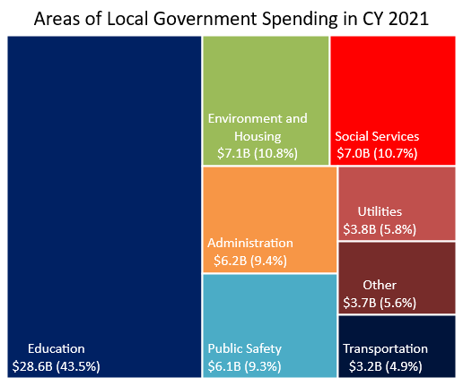
Ohio’s local government expenditures reached more than $65.7 billion in CY 2021
Local government spending totaled more than $65.7 billion in CY 2021.
  Of total spending, $55.1 billion (83.9%) was for services and government operations and $8.1 billion (12.3%) for capital outlays.
  Local government payroll expenditures amounted to nearly $25.5 billion (38.8%).
Local governments collected $66.3 billion in CY 2021.
  Local governments generated $40.9 billion (61.7%) from their own sources. This included $27.9 billion (42.1%) from property, income, sales, and other taxes, and $13.0 billion (19.6%) from service charges and miscellaneous revenues.
  Governmental transfers, mainly from the state, accounted for $21.8 billion (32.9%) in revenue. Local government utilities generated $3.4 billion (5.1%). The remaining $0.2 billion (0.3%) came from other sources.
Local governments hold $59.5 billion in outstanding debt.
  Long-term debt accounts for $58.7 billion (97.1%) of the debt.
  Public debt for private purposes totals $21.7 billion (37.5%) of the long-term debt issued.
Source: U.S. Census Bureau

